Slide 1
Presentation On
Watermarking of Grayscale Images Using Alpha Blending

Slide 2
Presented By
Lokpati Tiwari ROLL:380216010042
Anusree Nath ROLL:380216020015
Rajesh Nandi ROLL:380216010063
Subhadeep Ghosh ROLL:380216010103
Project Guide –
ANIRBAN PATRA

Slide 3
Objective of the Project
Copyright Protection
Authenticity Checking
Image Steganography

Slide 4
Works Till Now for Watermarking
Using Bit Plane Slicing (LSB Watermarking)
Using Discrete Fourier Transform
Using Discrete Wavelet Transform

Slide 5
Our Proposed Scheme
Watermarking of Grayscale Image using Alpha Blending
For our experiment we have used Two Gray scale Images

Slide 6
Alpha Blending
Alpha blending is a method by which we can modify the intensity value of pixel using alpha(ɑ)
This modification is done in both Images. Value choosen for alpha(ɑ) between (0-1).
g(x,y)=ɑ×f1(x,y) + (1-ɑ)×f2(x,y)

Slide 7
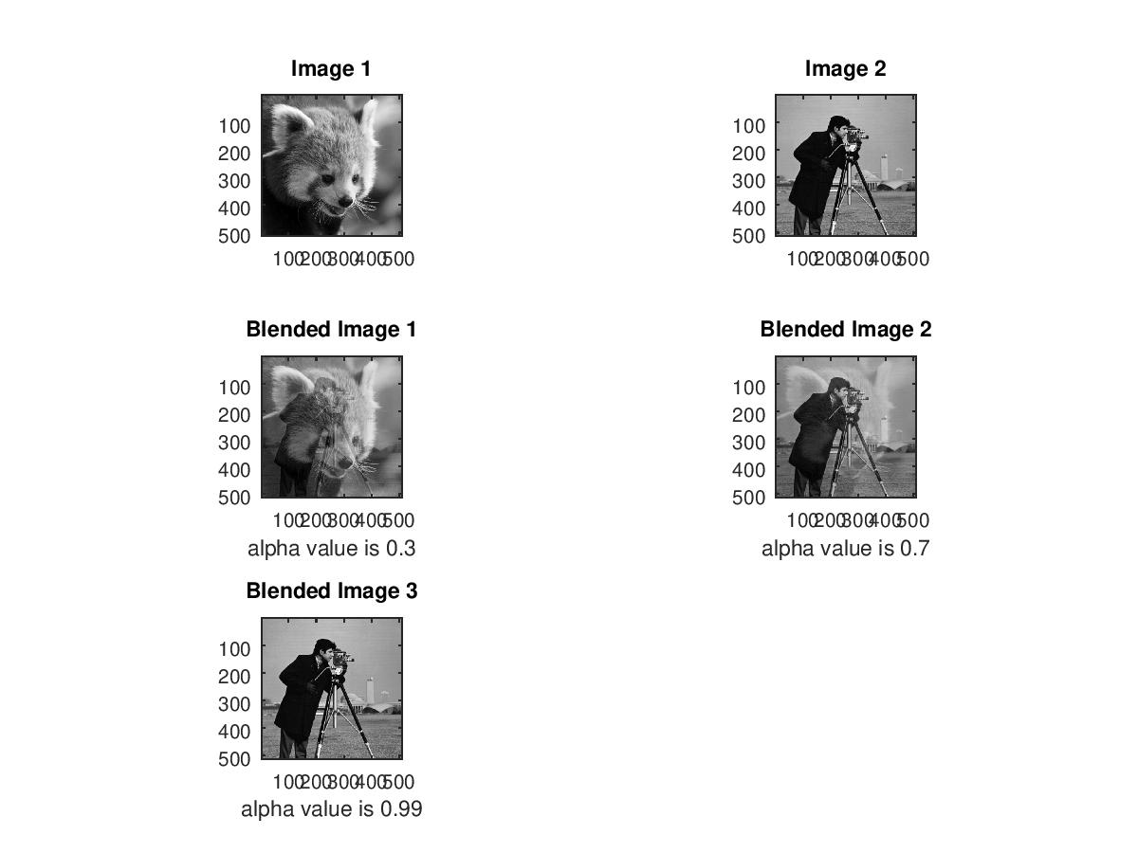
How it works:

Slide 8
Methodology
Then the intensity value of each pixel of Gray scale Images are modified by using a particular value of alpha
Two modified values are added together

Slide 9
Conclusion
From the images it has been observed than blending with Gray scale images is suitable for watermarking. .This technique can be used for Image Steganography ( hiding an image by another image) also. In future, we will work watermarking with RGB images.

Slide 10
Future Plan
To work on Colour Image

Slide 11
Reference
A Patra, A Saha, A K Chakraborty ; International Research Journal of Engineering and Technology (IRJET)
P Sharma, S Swami; Digital Image Watermarking Using 3 level Discrete Wavelet Transform ; Conference on Advances in Communication and Control Systems 2013
Chitla Arathi,’’ A Semi Fragile Image Watermarking Technique Using Block Based SVD”, Proceedings of International Journal of Computer Science and Information Technologies
G Kaur, K Kaur ; Image Watermarking Using LSB (Least Significant Bit) ; International Journal of Advanced Research in Computer Science and Software Engineering
A. Kannammal, K. Pavithra, S. Subha Rani, “Double Watermarking of Dicom Medical Images using Wavelet DecompositionTechnique”, Proceedings of European Journal of Scientific Research
L Rajab, T Al-Khatib, Ali Al-Haj ; A Blind DWT-SCHUR Based Digital Video Watermarking Technique ; Journal of Software Engineering and Applications

Slide 12
Thank You

Slide 13


